Slide 1
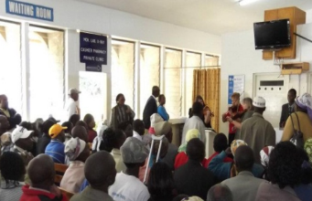
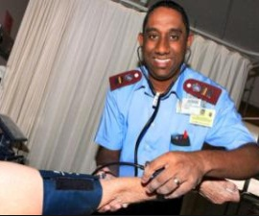
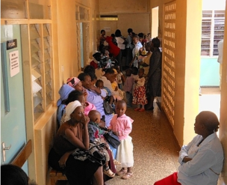
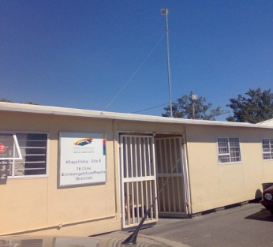
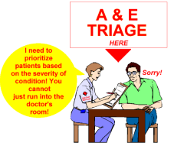
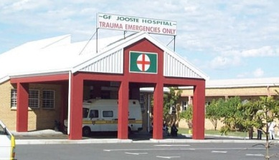
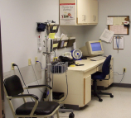
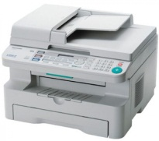
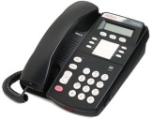
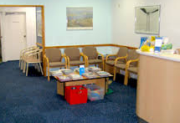
Private Healthcare centre
Public Healthcare centre
Home
Waiting Room
Triage
Waiting Room Healthcare provider
After referral Clinic or Hospital
Only TB & HIV/AIDS cases to Clinic inside Micheal Mapongwana day hospital.
Jooste Hospital referral or transfer letter. Only when need further advance medical
Capturing all patient data on PC & Folders
Check blood pressure, sugar levels etc
Dr. will examine/diagnose patient then give prescription for Pharmacy if need be or refer to HIV/TB clinic or Hospital depend to the diagnose
ICT types use for referral & transfer: Letter of referral, Telephone, Email, Fax machine, Courier etc.
Dr will examine/diagnose patient then give prescription for Pharmacy if need be.
Going Home/Pharmacy
Journey and stages of patient
in Healthcare centre Khayelitsha
Capturing all patient data on PC & Folders

